Slide 1
Conference in Stockholm 12 - 14 September 2018

Slide 2
Our History (so far)
2018
Rainer J. Lamm joins as new partner
2008
Start of business 4 partners 1 secretary
2018
10th anniversary 4 partners 9 employees about 750 clients
2013
5th anniversary 4 partners 7 employees about 580 clients
2017
Member of CH International
2016
Retirement of co-founding partner Gerhard Kröller

Slide 3
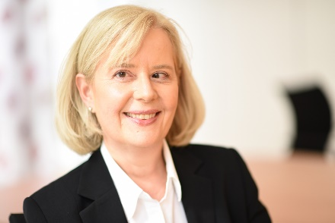
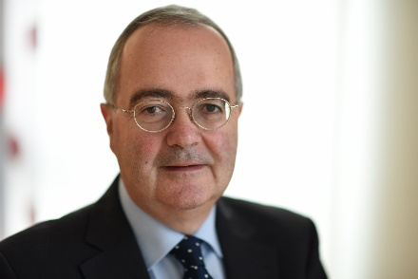
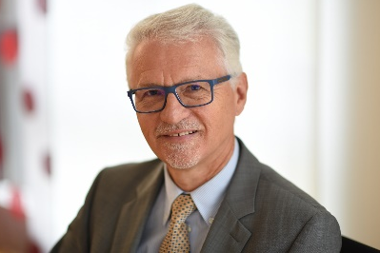
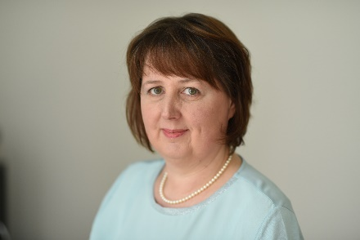
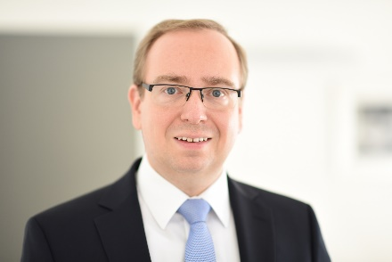
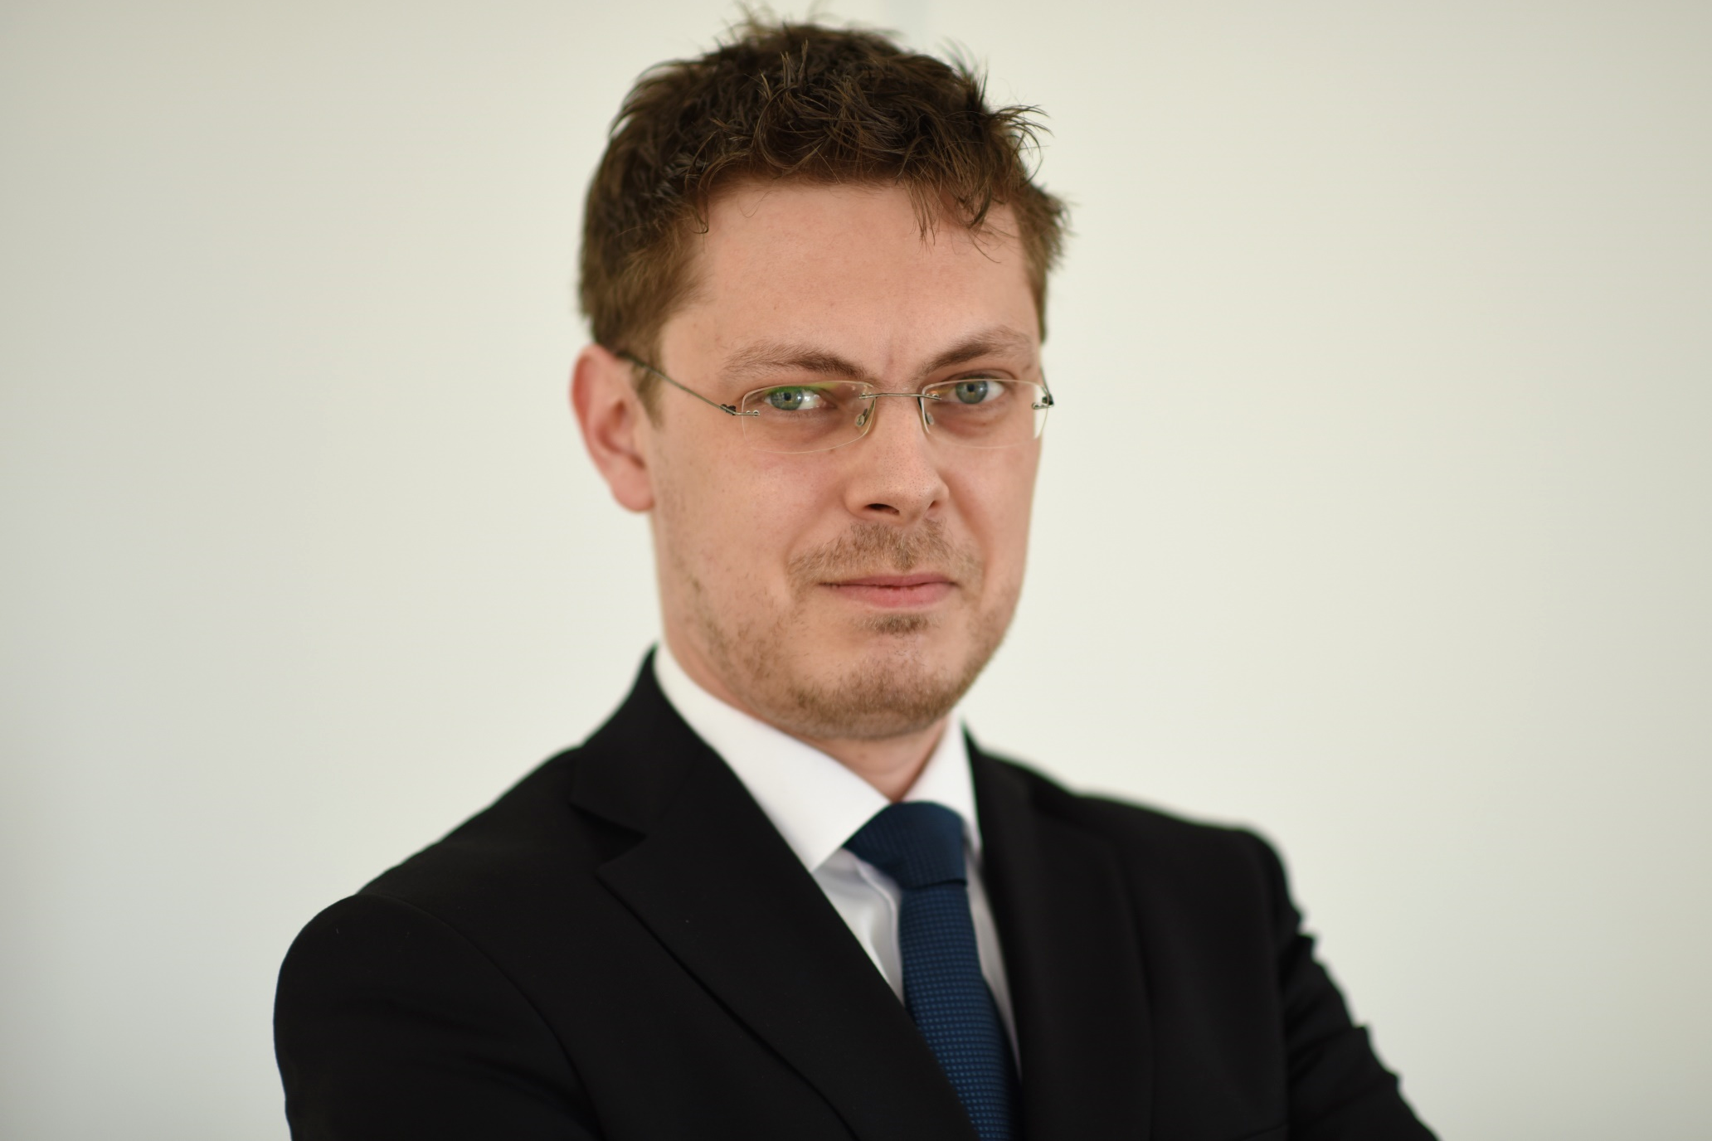
Our Partners / Specialists
Elke Fischer (Partner)
Steuerberaterin
Reiner Dürr (Partner)
Steuerberater
Gerhard Kröller
Steuerberater
Ines Ferger (Partner)
Steuerberaterin
Rainer J. Lamm (Partner)
Wirtschaftsprüfer, Steuerberater
Sebastian Lackus
Steuerberater

Slide 4
Our Professional Team
Tax Advisors
Tax Assistants
Business Economists
Accounting Clerks
Secretaries
Chartered Accountants

Slide 5
Our Services
Consultancy for Businesses and Individuals
Financial and payroll accounting
Annual accounts and tax returns
VAT
Customs & excise
Assistance with government tax audits
Appeals (both administrative and before courts)
Tax planning (M&A / restructuring, inheritance tax etc.)
Expert opinions, incl. court expert opinions

Slide 6
Our Services
Consultancy for Consultants
Consultancy for currently more than 130 tax consultants or their clients in specifically defined areas, either in individual cases or on a continual basis.
Discussion of any cases openly or just by abstract facts without naming the client.
Second opinions.
Tax consultants often ask us for assistance with international tax issues for their clients.

Slide 7
Our Newsletter
In our regular newsletter “dffk | kompakt” for clients and business contacts, we cover current topics such as
internal dffk news
current tax issues
new legislation
court decisions

Slide 8
Our Quality Management
Regular external and internal trainings for partners and technical staff
Checklist system for all types of tax compliance work
Vocational training of our own tax assistants
Four-eyes principle
Replacement cover is ensured in cases when a partner or staff member is temporarily not available

Slide 9
Our Country and our Region
Stuttgart is the capital of the Federal State of Baden-Württemberg
one of the leading economic regions not only in Germany but also in Europe
home to internationally renowned corporations and thousands of successful small and medium-sized enterprises
known for its innovative drive and inventive spirit, with a high level of productivity and low unemployment
leading exporter in Germany

Slide 10
Our Country and our Region
Industrial giants and a strong medium-sized backbone
Economic strength
Land of inventors
Qualified workforce as our most important asset
Research and production in important future areas such as
sustainable mobility
environmental technology and resource efficiency
health and healthcare
embedded systems and IT services

Slide 11
We look forward to working with you in Thank you for your attention!

